Slide 1
Slouch-o-meter
Cues /arm hackathon
The Pemgineers: Oli Dunkley, siddharth gupta, Laurence cochrane, Bianca bilovolschi

Slide 2
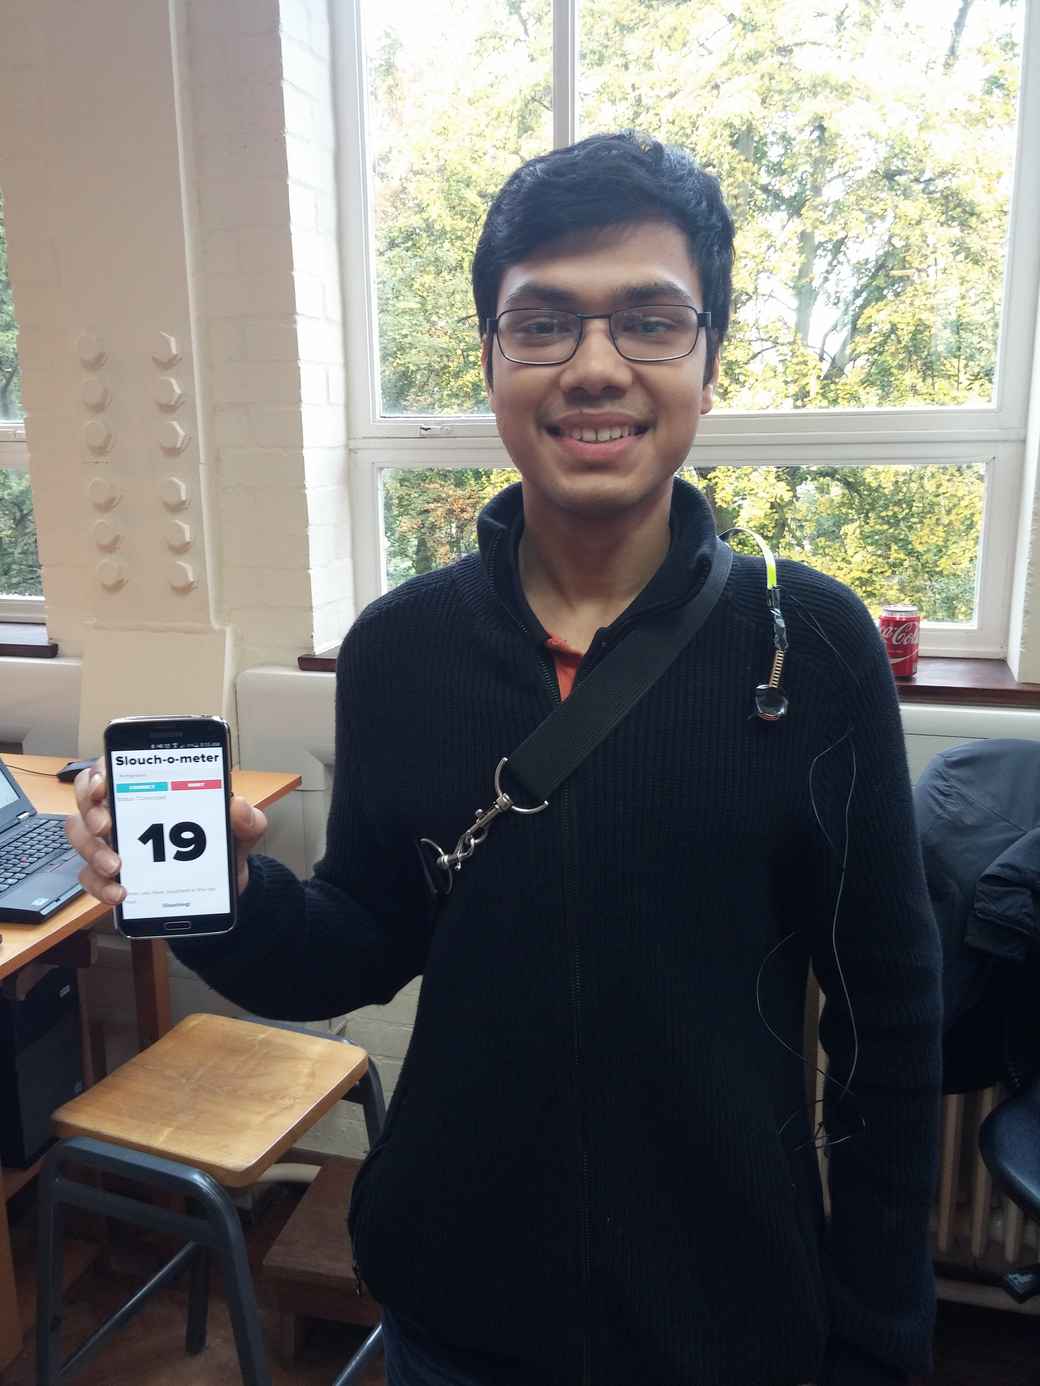

Slide 3
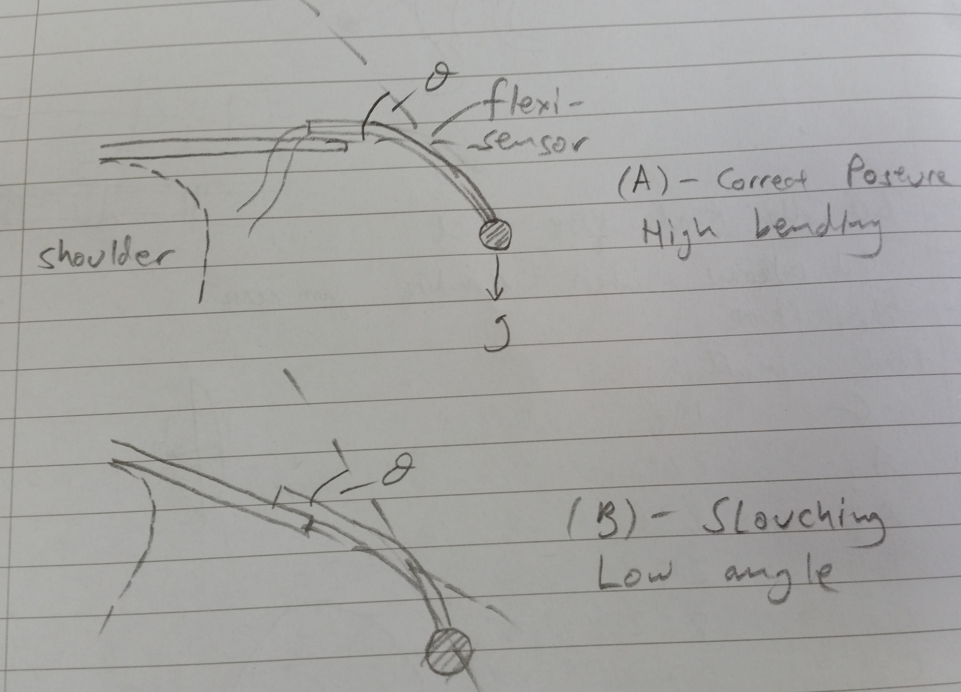

Slide 4
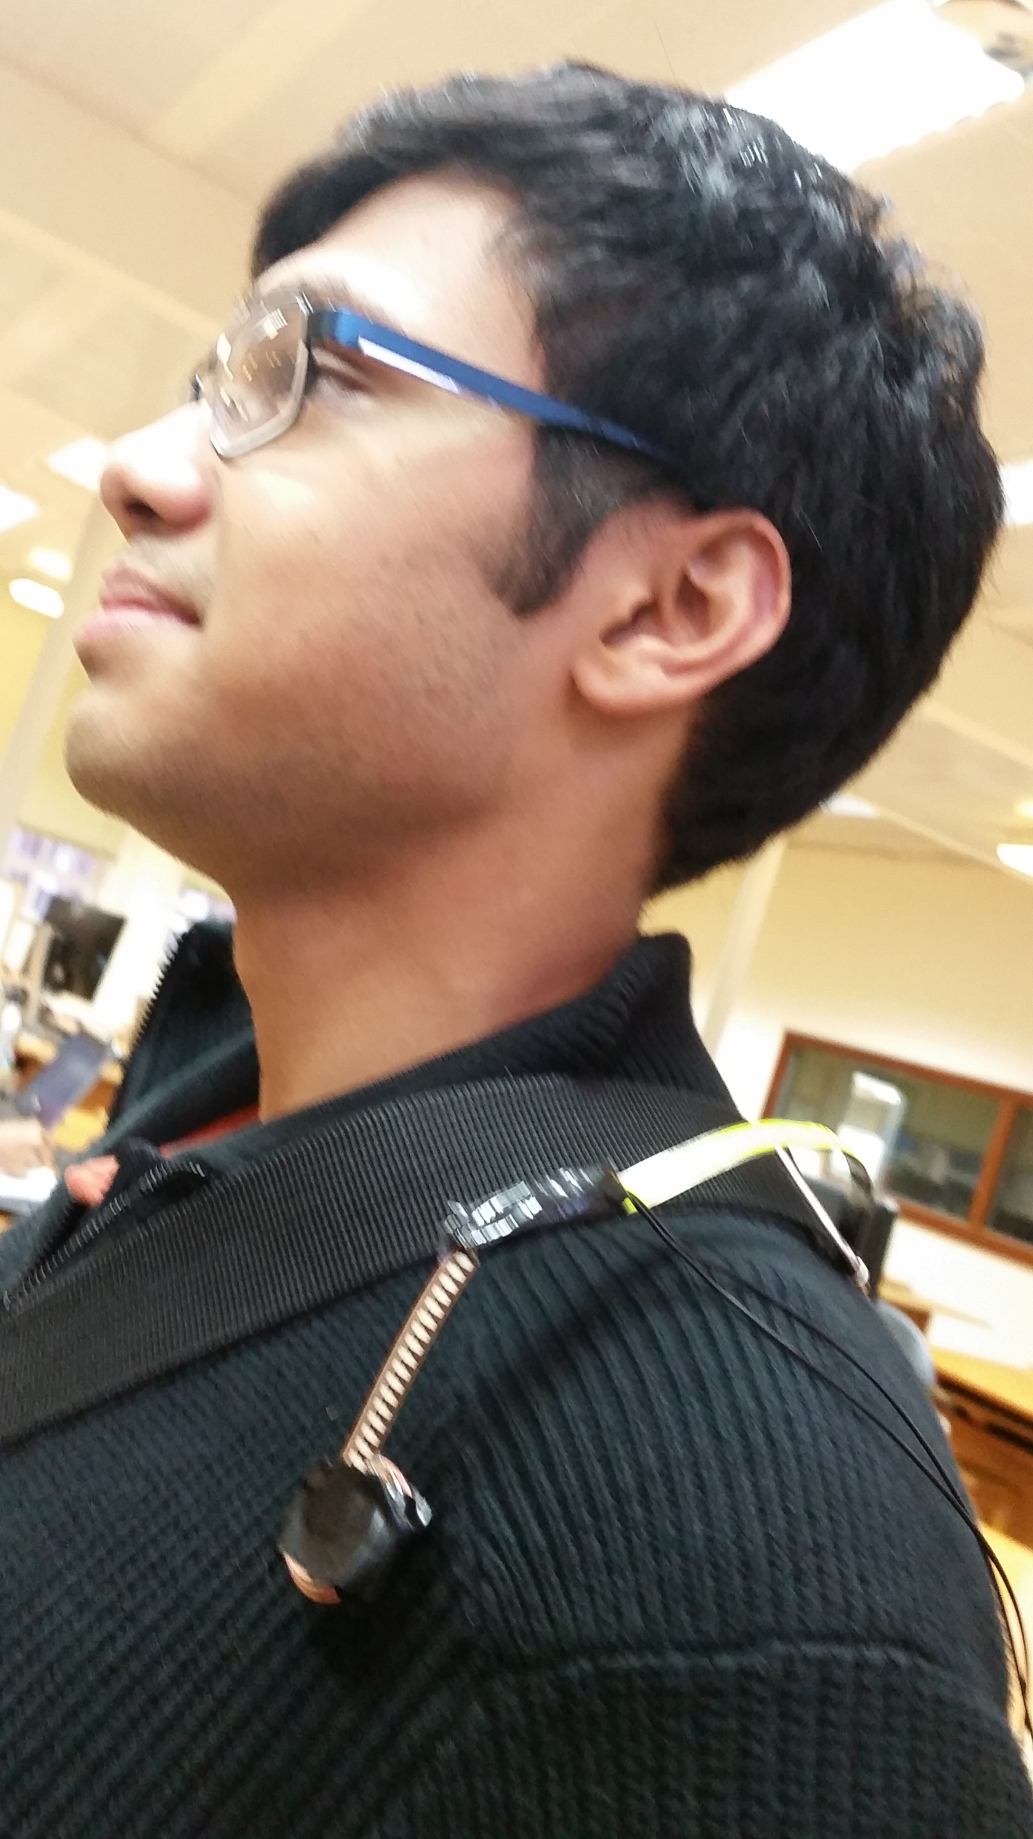

Slide 5
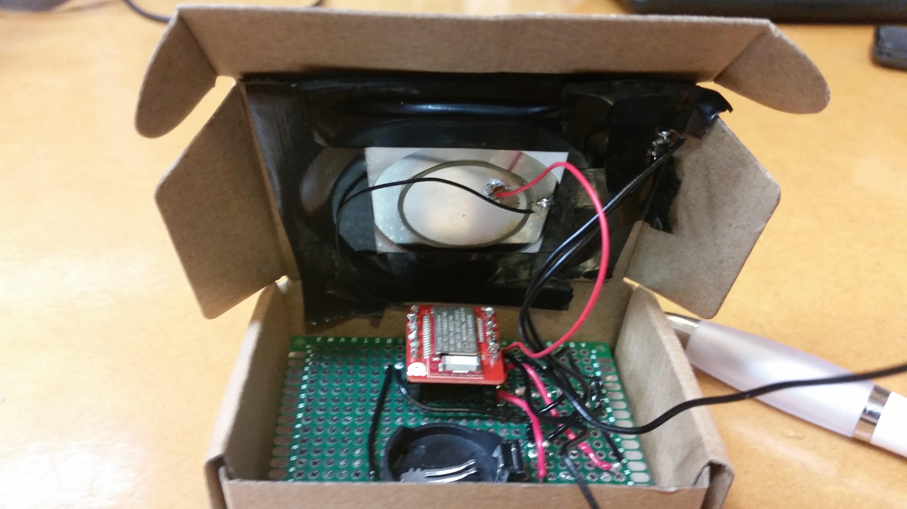

Slide 6
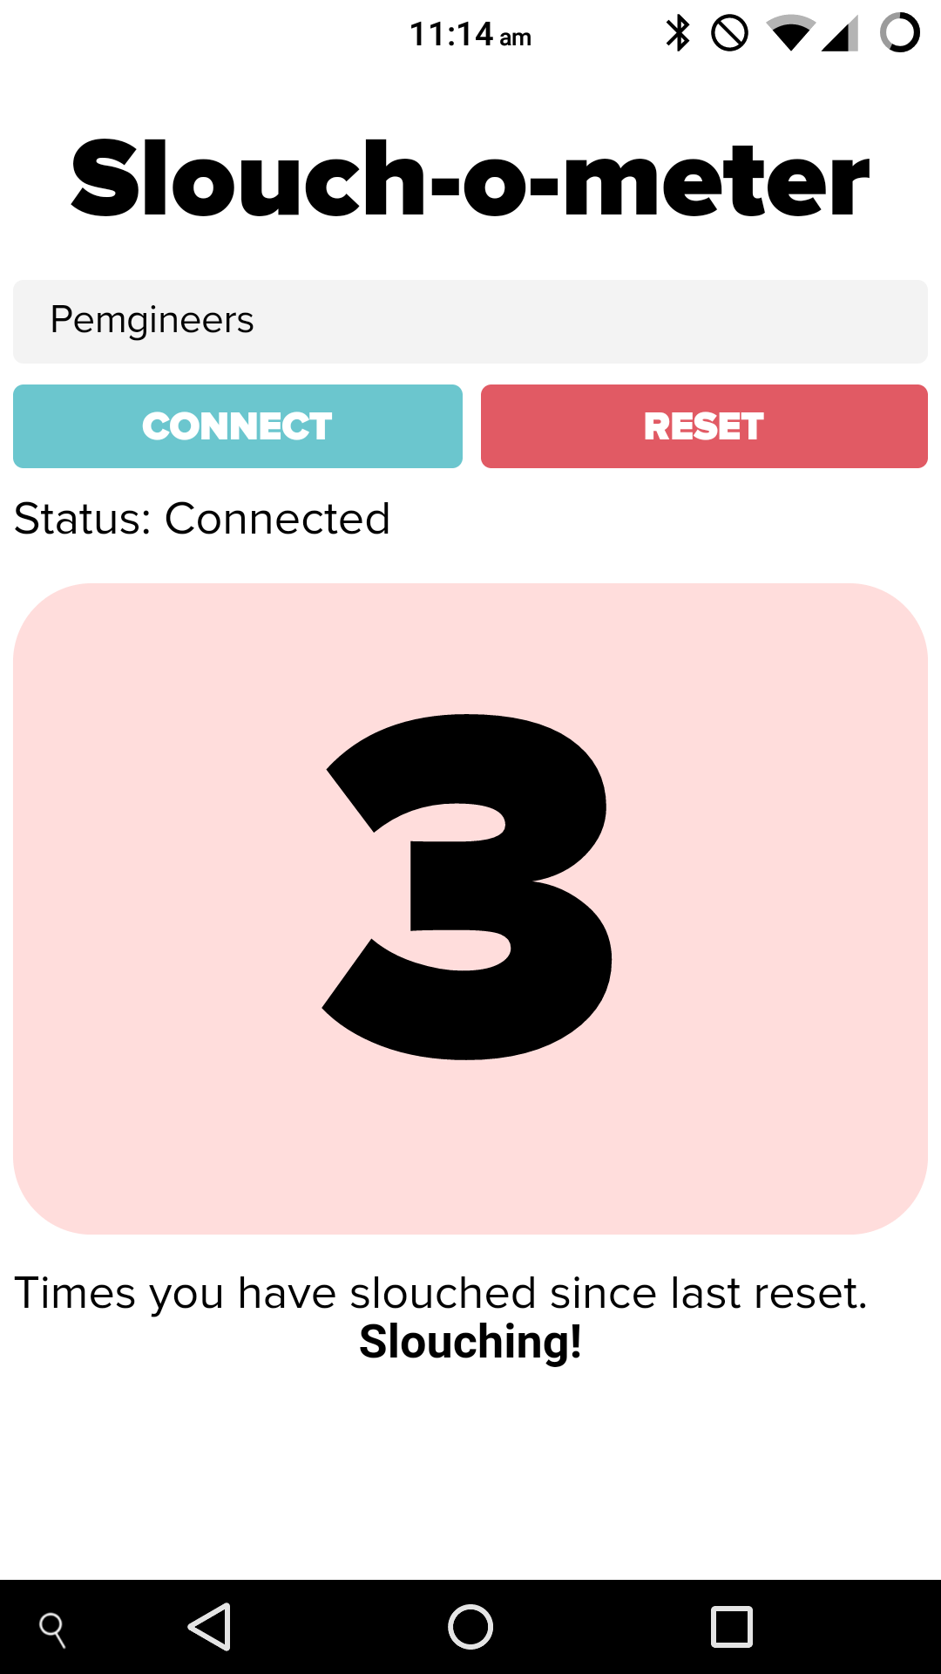
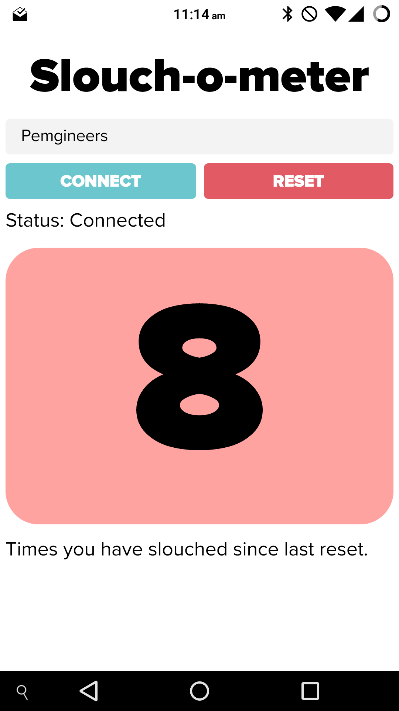

Slide 7
Thanks for listening

